Slide 1
Multiple regression
DETERMINING THE WAY PLAYERS SPEND THEIR GOLD.
Student Name:
Admission Number:

Slide 2
Import The data
>str(match_data)
'data.frame': 50000 obs. of 13 variables:
$ match_id : int 0 1 2 3 4 5 6 7 8 9 ...
$ start_time : int 1446750112 1446753078 1446764586 1446765723 1446796385 1446798766 1446800938 1446804030 1446819063 1446837251 ...
$ duration : int 2375 2582 2716 3085 1887 1574 2124 2328 2002 2961 ...
$ tower_status_radiant : int 1982 0 256 4 2047 2047 1972 2046 0 0 ...
$ tower_status_dire : int 4 1846 1972 1924 0 4 0 0 1982 1972 ...
$ barracks_status_dire : int 3 63 63 51 0 3 3 0 63 63 ...
$ barracks_status_radiant: int 63 0 48 3 63 63 63 63 0 0 ...
$ first_blood_time : int 1 221 190 40 58 113 4 255 4 85 ...
$ game_mode : int 22 22 22 22 22 22 22 22 22 22 ...
$ radiant_win : chr "True" "False" "False" "False" ...
$ negative_votes : int 0 0 0 0 0 0 0 0 0 0 ...
$ positive_votes : int 1 2 0 0 0 0 0 0 0 0 ...
$ cluster : int 155 154 132 191 156 155 151 138 182 133 ..
>str(players_ratings)
'data.frame': 834226 obs. of 5 variables:
$ account_id : int 236579 -343 -1217 -1227 -1284 308663 79749 -1985 -2160 26500 ...
$ total_wins : int 14 1 1 1 0 1 21 0 8 26 ...
$ total_matches : int 24 1 1 1 1 1 40 1 12 50 ...
$ trueskill_mu : num 27.9 26.5 26.5 27.2 22.9 ...
$ trueskill_sigma: num 5.21 8.07 8.11 8.09 8.09 ...

Slide 3
Subdivide data into smaller subsets
match_data <- head(match_data, 600)
players_data <- head(players_data, 600)
players_ratings <- head(players_ratings, 600)

Slide 4
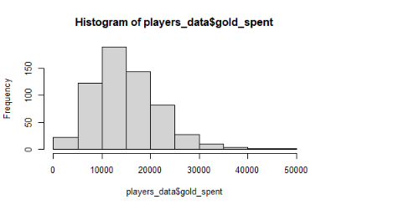
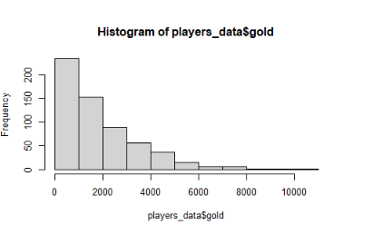
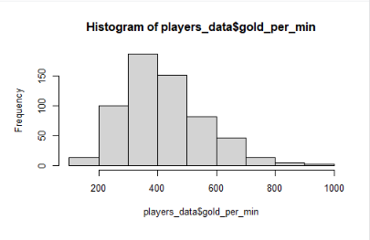
Plot the data
Gold Spent
Gold
Gold Per Minute

Slide 5
Create Models
> model_match <- lm(match_id ~ radiant_win, data = train)
> summary(model_match)
Call:
lm(formula = train$match_id ~ train$radiant_win)
Residuals:
Min 1Q Median 3Q Max
-319.07 -151.95 1.43 150.04 307.41
Coefficients:
Estimate Std. Error t value Pr(>|t|)
(Intercept) 320.07 11.79 27.147 <2e-16 ***
train$radiant_winTrue -32.48 16.39 -1.982 0.0481 *
---
Signif. codes: 0 ‘***’ 0.001 ‘**’ 0.01 ‘*’ 0.05 ‘.’ 0.1 ‘ ’ 1
Residual standard error: 173.7 on 448 degrees of freedom
Multiple R-squared: 0.008695, Adjusted R-squared: 0.006482
F-statistic: 3.93 on 1 and 448 DF, p-value: 0.04805
> model_players <- lm(gold_spent ~ match_id + gold, data = train_players)
> summary(model_players)
Call:
lm(formula = gold_spent ~ match_id + gold, data = train_players)
Residuals:
Min 1Q Median 3Q Max
-14698 -4823 -1071 4076 34614
Coefficients:
Estimate Std. Error t value Pr(>|t|)
(Intercept) 13146.9902 710.1067 18.514 < 2e-16 ***
match_id -0.2445 18.7883 -0.013 0.99
gold 1.0894 0.1993 5.465 7.69e-08 ***
---
Signif. codes: 0 ‘***’ 0.001 ‘**’ 0.01 ‘*’ 0.05 ‘.’ 0.1 ‘ ’ 1
Residual standard error: 6867 on 447 degrees of freedom
Multiple R-squared: 0.06305, Adjusted R-squared: 0.05886
F-statistic: 15.04 on 2 and 447 DF, p-value: 4.767e-07
> model_ratings <- lm(total_matches ~ total_wins + account_id, data = players_ratings)
> summary(model_ratings)
Call:
lm(formula = total_matches ~ total_wins + account_id, data = players_ratings)
Residuals:
Min 1Q Median 3Q Max
-15.476 -1.331 -0.128 1.191 19.481
Coefficients:
Estimate Std. Error t value Pr(>|t|)
(Intercept) 4.289e-01 1.660e-01 2.583 0.010 *
total_wins 1.873e+00 1.101e-02 170.176 <2e-16 ***
account_id -7.012e-07 1.360e-06 -0.515 0.606
Signif. codes: 0 ‘***’ 0.001 ‘**’ 0.01 ‘*’ 0.05 ‘.’ 0.1 ‘ ’ 1
Residual standard error: 3.554 on 597 degrees of freedom
Multiple R-squared: 0.98, Adjusted R-squared: 0.9799
F-statistic: 1.462e+04 on 2 and 597 DF, p-value: < 2.2e-16

Slide 6
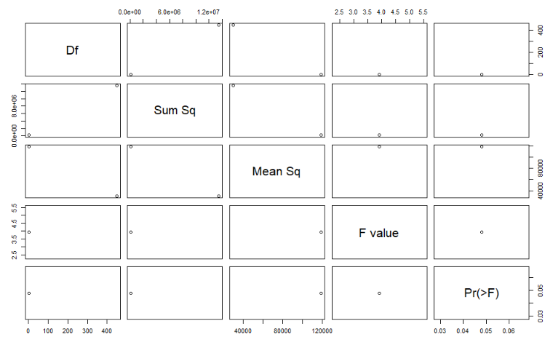
Model comparison
> anova_model <- anova(model_ratings, model_match, model_players)
> summary(anova_model)

Slide 7
Prediction and Diagnostics
# Prediction
pred <- predict(model_match, test)
pred2 <- predict(model_players, test_players)
pred3 <- predict(model_ratings, test_ratings)
# Diagnostic Measures on the models
> AIC(model_match)
[1] 5922.553
> AIC(model_players)
[1] 9233.093
> AIC(model_ratings)
[1] 3229.481

Slide 8
Accuracy emulation
# Accuracy
> pred1 <- data.frame(cbind(actuals=test$match_id, predicteds = pred))
> pred_2 <- data.frame(cbind(actuals=test_players$gold_spent, predicteds = pred2))
> pred_3 <- data.frame(cbind(actuals = test_ratings$total_wins, predicteds = pred3))
# Correlation Accuracy
> head(accuracy1)
actuals predicteds
actuals 1.00000000 0.01519983
predicteds 0.01519983 1.00000000
> head(accuracy2)
actuals predicteds
actuals 1.0000000 0.2561862
predicteds 0.2561862 1.0000000
> head(accuracy3)
actuals predicteds
actuals 1.0000000 0.9999957
predicteds 0.9999957 1.0000000

